Slide 1



Slide 2

Group_Members_4:
THADAKMALLA SRINIVASA SAI SHISHIR
RONAK SULTANA ASGARI
MUHAMMED SHAZ ASHRAF
VADITHIYA PAVAN KUMAR NAIK
ANAPURAM SANJAY
BANDARU DURGA SWATHI

Slide 3

Content:
Project Architecture
Introduction to Bankruptcy
Workflow Overview
Methodology and Dataset Details
​Data ​Visualization
Model Building and Training
Model evaluation and Accuracy Comparison
Final Model Selection
Model Deployment
Conclusion

Slide 4





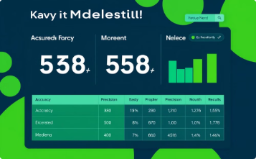

Project Architecture
Datasets
Data Cleaning
Data Preprocessing
Model Building
Model Evaluation
Model Deployment

Slide 5


Bankruptcy Means...
Bankruptcy:
Legal process for those unable to repay debts.
Involves liquidation or debt reorganization.
Leads to financial distress and credit impact.
Non-Bankruptcy:
Financial stability with ability to repay debts.
Indicates solvency and good credit standing.
Represents effective debt management.

Slide 6

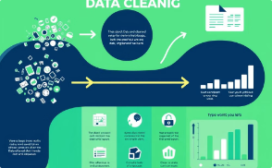
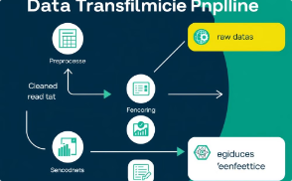


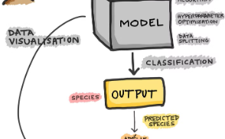


Workflow Overview:
This phase involves understanding the data, identifying potential issues, and preparing it for modeling.
Data Collection
Data preprocessing
Data Transformation
Collet and load the dataset
Handle missing values, remove duplicates, fix datatypes, Normalization, Splitting dataset into Train-Test sets
Scaling, encoding, and converting data to
suitable formats for modeling.
Data Visualization
Model Building
Model Evaluation
Uses histogram for distribution, Boxplot for outliers,
Heatmap for correlation,
Select Algorithm, Split and Train Model, Prediction
Evaluate the model with Accuracy_score and do the prediction
Model deployment
Streamlit

Slide 7





Methodologies:
Language:
Libraries:
Algorithm Used:
Interface:
Python
Pandas, NumPy, Matplotlib, Seaborn, Scikit-Learn
Logistic Regression, Gaussian Naive Bayes, Random forest Classifier, Decision Tree
Streamlit

Slide 8

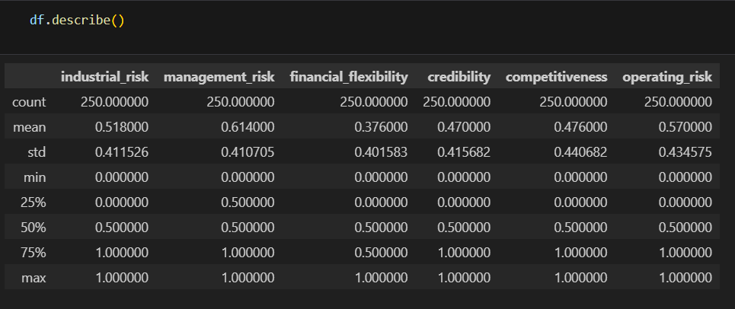
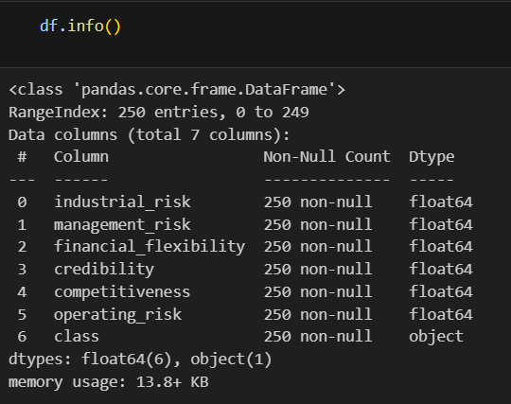
Data-Set Details:
Selection of Dataset: Bankruptcy
Target Columns: class
Feature Columns: industrial_risk, management_risk
finanial_flexibility, credibility, competitivness, operating_risk
Label Encoder: using Label encoder for target column

Slide 9

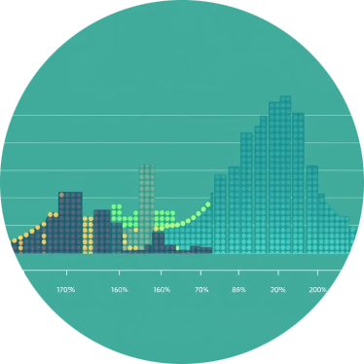
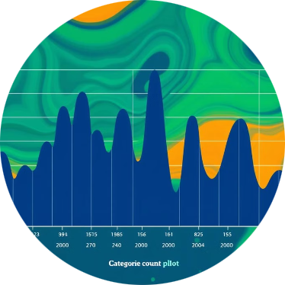
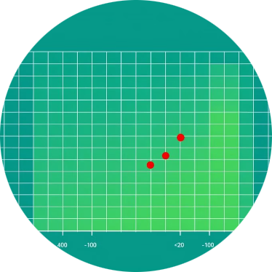
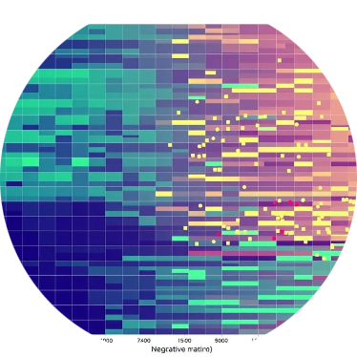
Data visualization:
Data visualization is the graphical representation of information and data. It uses visual elements like charts, graphs, and maps to present data in an accessible and understandable way. The goal is to help people quickly grasp trends, outliers, and patterns within a dataset.
Distribution Plots
Count Plots
Boxplot
Correlation Heatmap
Explored the spread of numerical features.
Visualized categorical feature distributions.
Used to find out the outliers.
Showed relationships among numeric features.

Slide 10
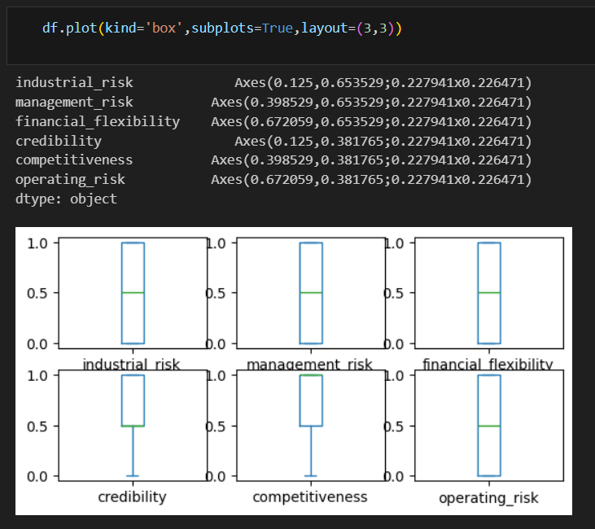
Boxplot:
Visualizes data distribution and outliers.
Shows five key values: minimum, Q1, median, Q3, and maximum.
Helps compare data across categories.

Slide 11

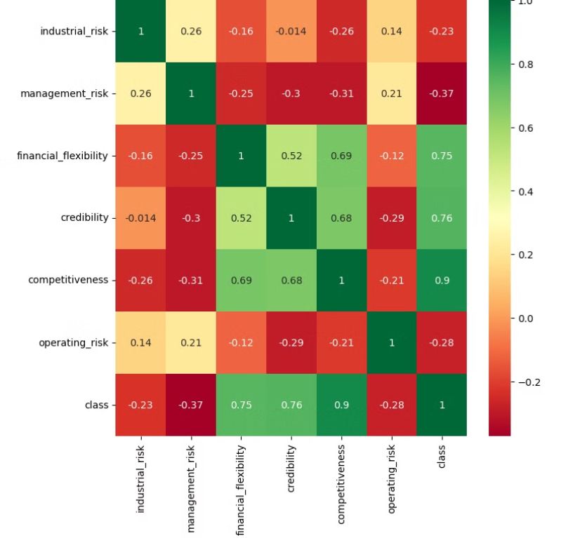
Correlation matrix using Heatmap.
A correlation matrix is a table showing correlation coefficients between a set of variables and a heatmap is a graphical representation of data where individual values are represented by varying colors.

Slide 12
Model Building
Model Building Steps:
Understand the Problem: Define objectives and target variable (e.g., Bankruptcy vs. Non-Bankruptcy).
Data Preparation:
Clean data (handle missing values and outliers).
Encode categorical variables and normalize/scale features if needed.
Split Data: Divide into training and testing sets (e.g., 70%-30%).
Choose Model: Select appropriate algorithm (e.g., Decision Tree, Random Forest, Logistic Regression).
Train Model: Fit the model on the training dataset.
Evaluate Performance:
Use metrics like accuracy, precision, recall, F1-score, or AUC-ROC.
Perform cross-validation if needed.
Optimize: Tune hyperparameters for better performance (e.g., grid search or random search).
Deploy: Use the final model for predictions on new data.

Slide 13
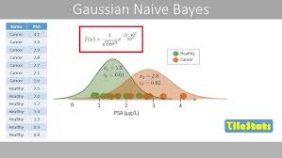
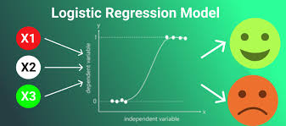
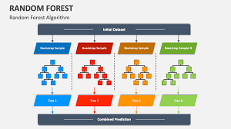
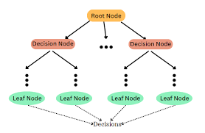
Model Building and Training
Gaussian Naive Bayes:
A probabilistic classifier based on Bayes' theorem.
Assumes features follow a Gaussian (normal) distribution.
Works well for small datasets and independent features.
Logistic Regression:
A classification algorithm for binary outcomes.
Models the probability of a class using a sigmoid function.
Suitable for linearly separable data.
Random Forest Classifier:
An ensemble of multiple Decision Trees.
Combines predictions for better accuracy and robustness.
Reduces overfitting compared to a single Decision Tree.
Useful for handling complex datasets with high-dimensional features.
Decision Tree:
Predicts outcomes by splitting data based on features.
Final decisions are made at leaf nodes (e.g., Bankruptcy or Non-Bankruptcy).
Easy to interpret and identify key risk factors.
Handles both categorical and numerical data effectively.

Slide 14
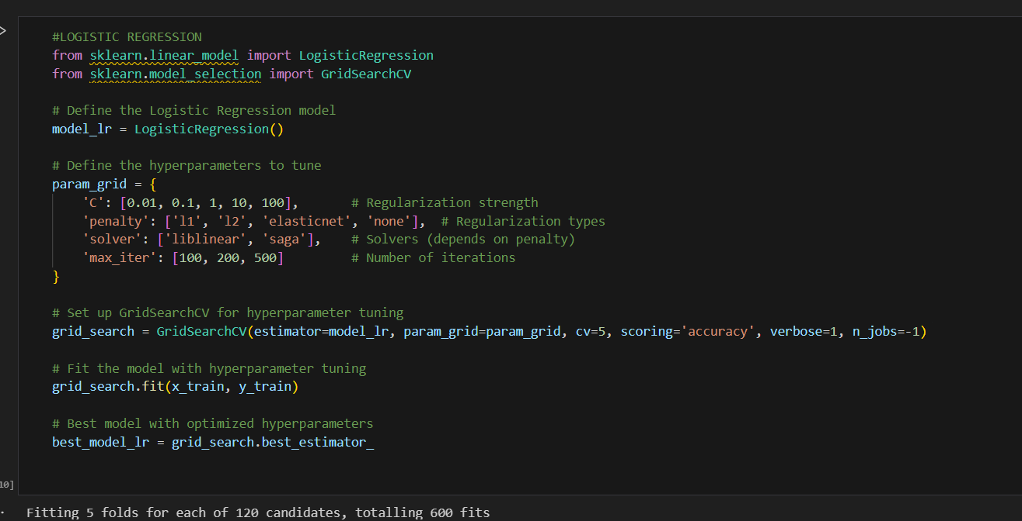
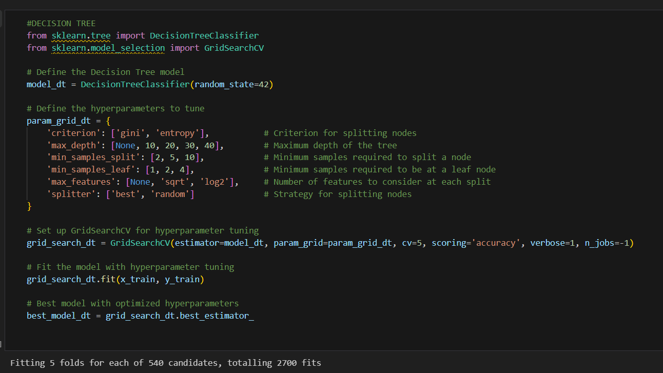
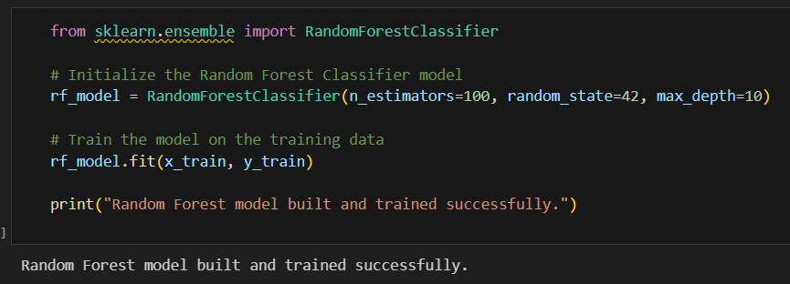
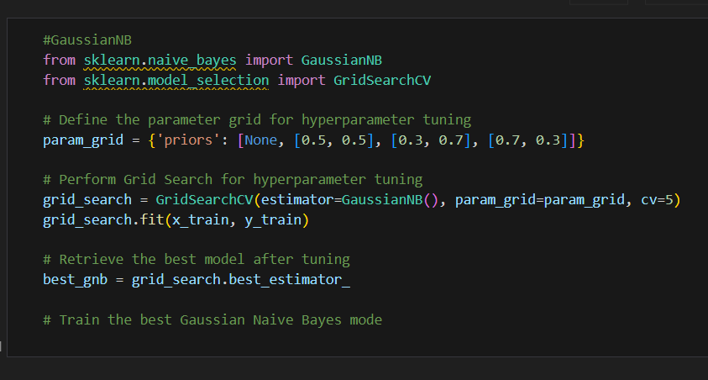
Logistic Regression Model
Decision Tree Model
Random Classifier Model
Gaussian Naïve Bayes Model

Slide 15

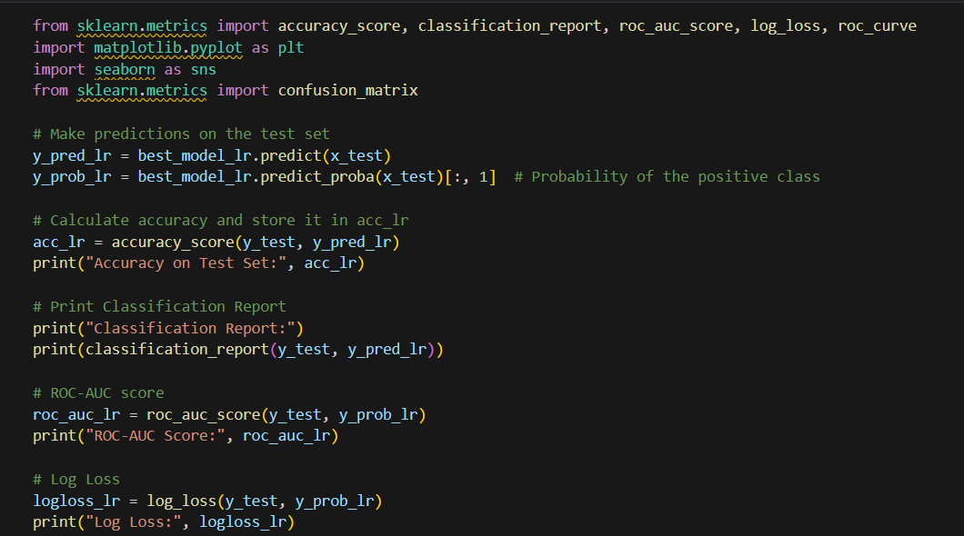
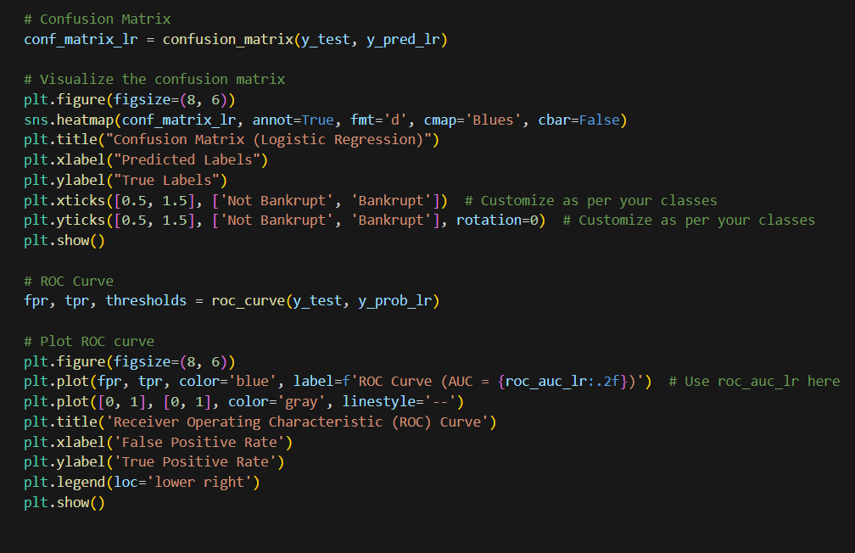
Model Evaluation: Accuracy Comparison
Logistic regression, Decision Tree achieved 96% accuracy ,Gaussian and Random Forest Classifier achieved 95% accuracy.

Slide 16
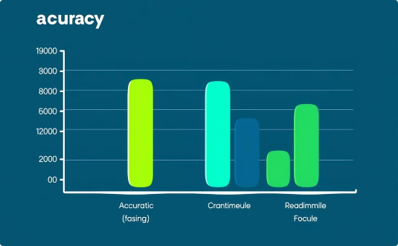


Accuracy
Precision & Recall
F1-Score
A measure of how often the model correctly predicts the outcome.
Precision measures the accuracy of positive predictions, while recall measures the ability to identify all positive cases.
The harmonic mean of precision and recall, providing a balanced measure of model performance.

Slide 17
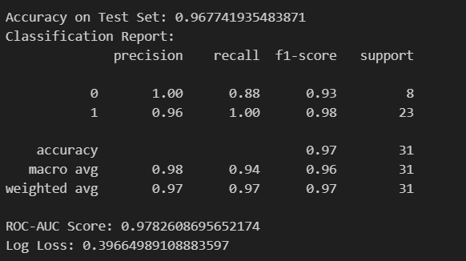
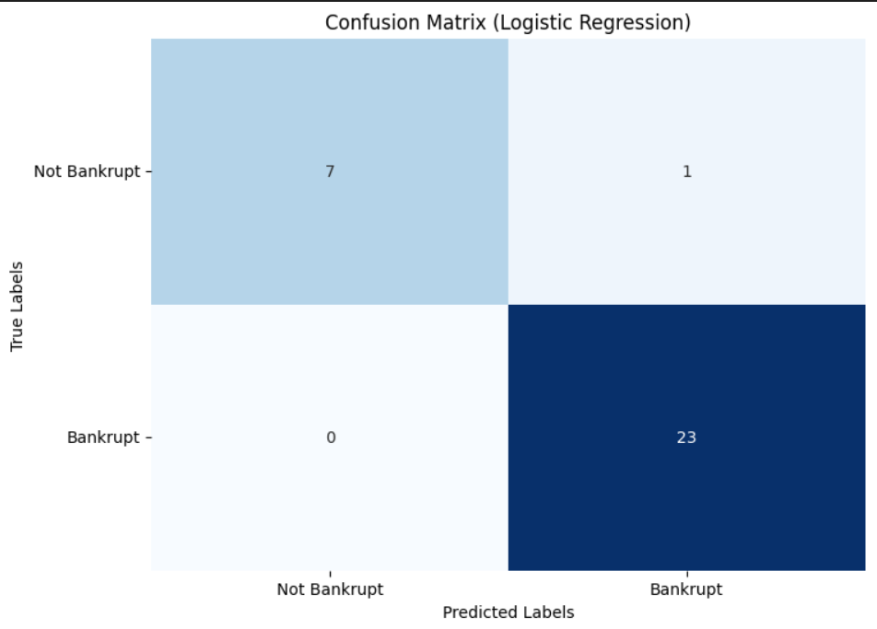
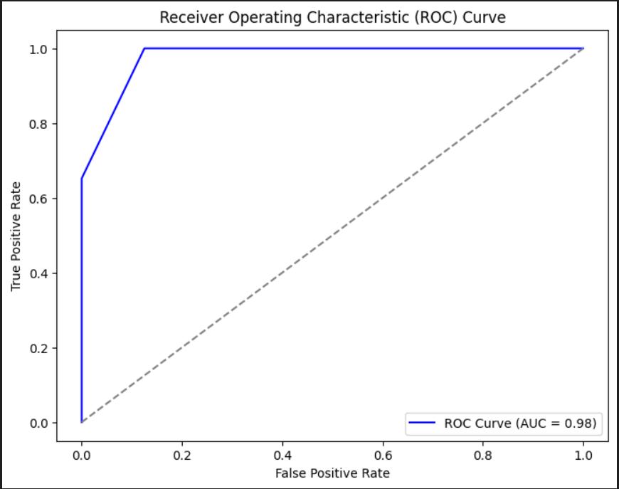
Final Model Selection:
The best-performing model, Logistic Regression, achieved 96% accuracy in our evaluation, making it the clear choice for deployment. This high accuracy was consistent across multiple evaluation metrics, demonstrating its robustness and reliability. Other models, such as Gaussian, Random Forest Classifier also performed well (95% accuracy), but Logistic Regression's superior performance and computational efficiency made it the most suitable option for our application. The simplicity and interpretability of Logistic Regression also contributed to its selection, as it allows for a more straightforward understanding of the model's predictions.

Slide 18
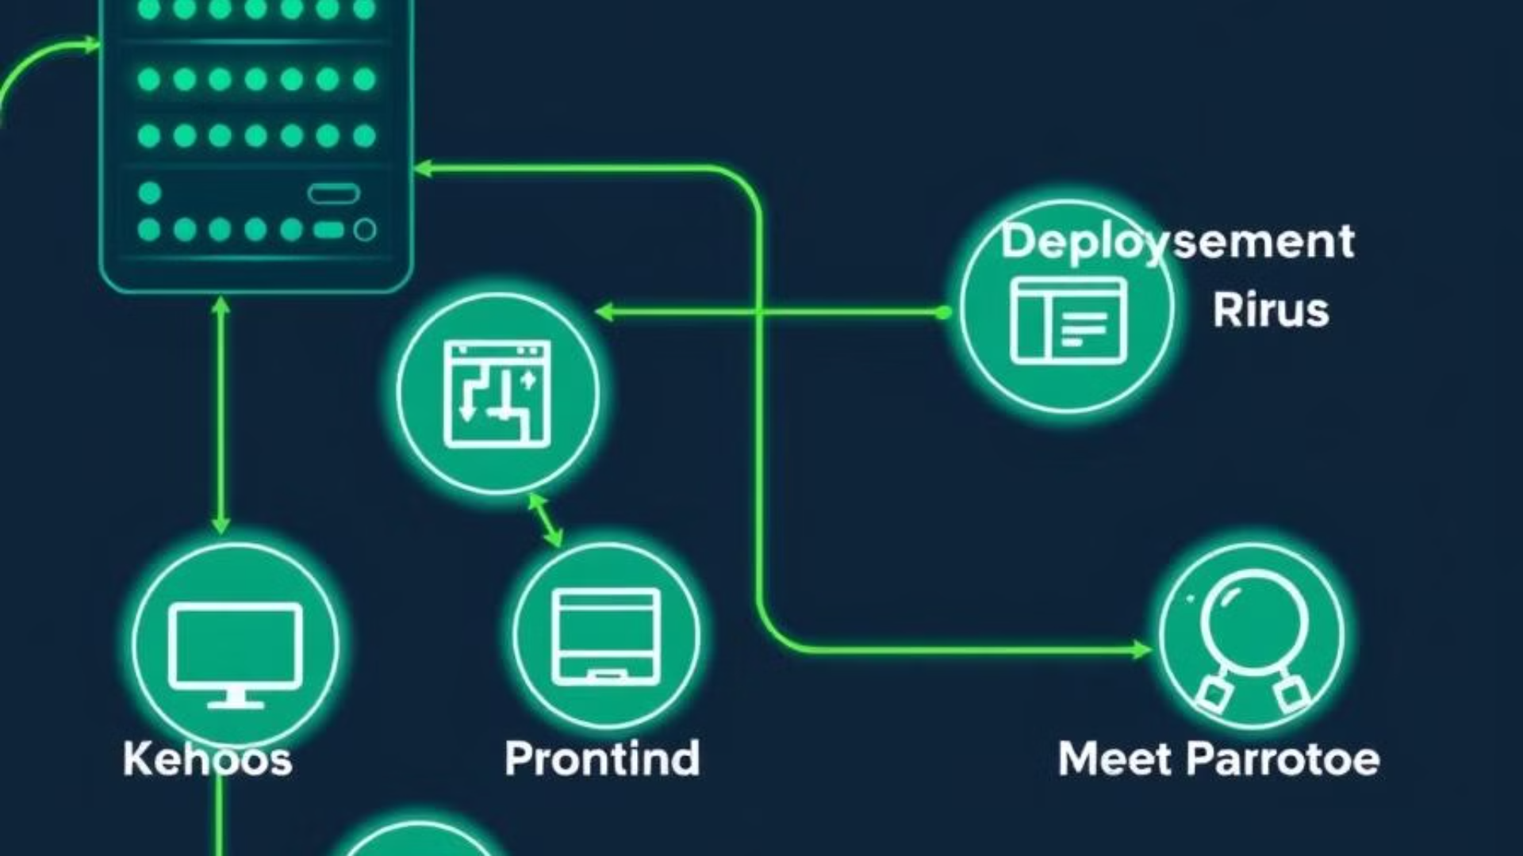
Model Deployment:
Integrating the Model
1
Model deployment integrates a trained machine learning model into a production environment for end-user or system predictions/insights.
Infrastructure Setup
2
Setting up infrastructure, APIs, or user interfaces ensures scalability and reliability for real-world usage.
Deployment Platforms
3
Platforms like Streamlit, Flask, AWS, Azure, or Docker deploy models as web applications or services.
Deployment Method
4
We used the pickle library. The Logistic Regression model and scaler were converted to .pkl files, then used with Streamlit for web-based predictions.

Slide 19
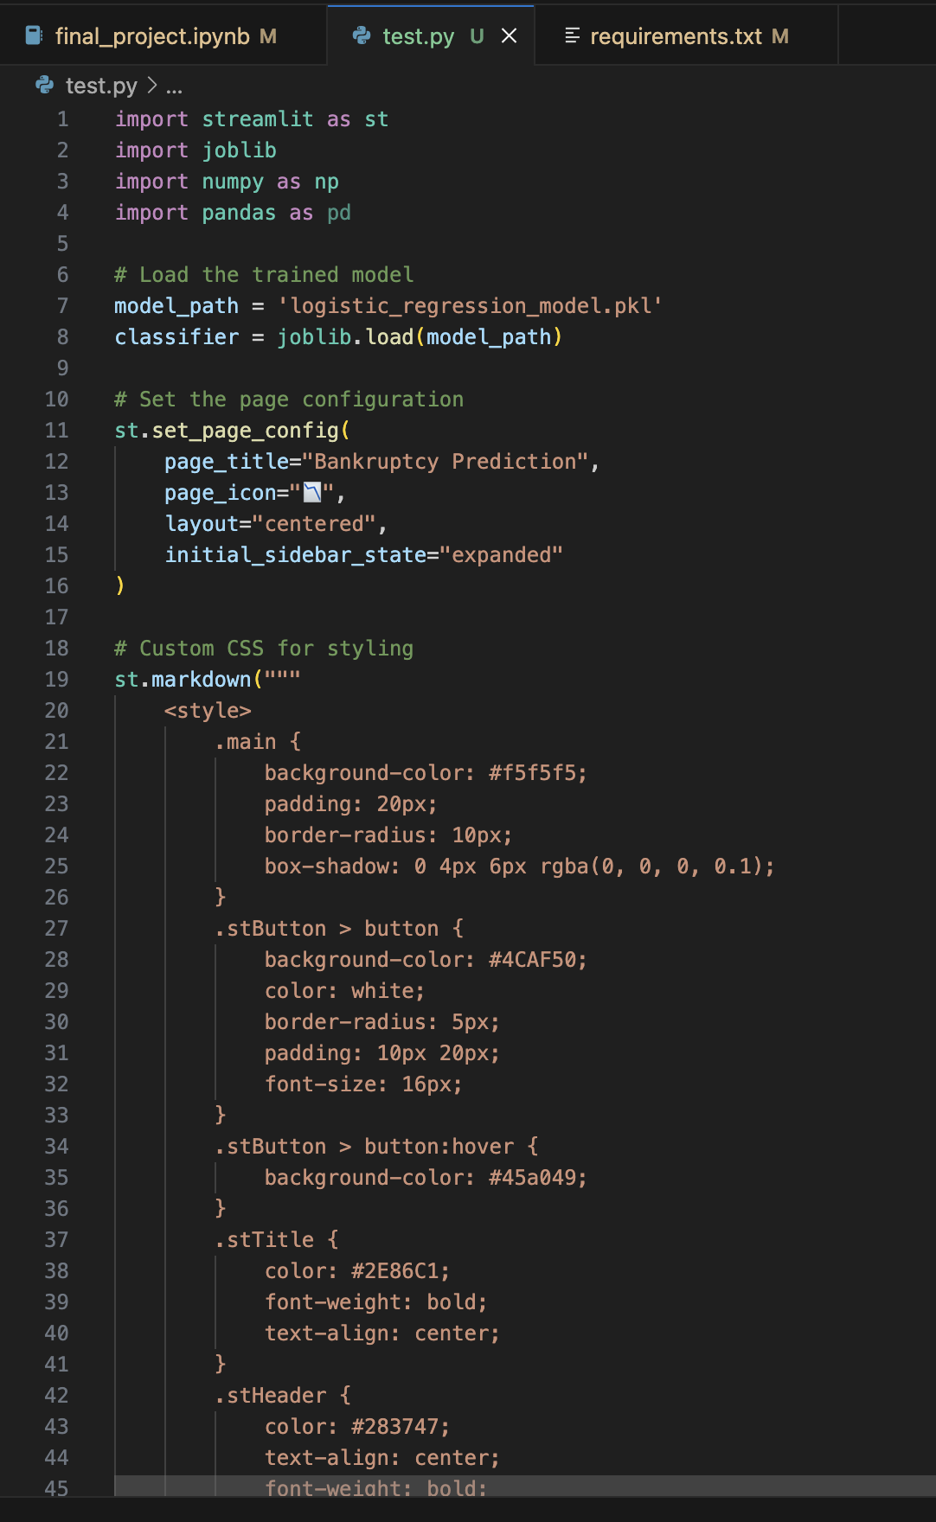
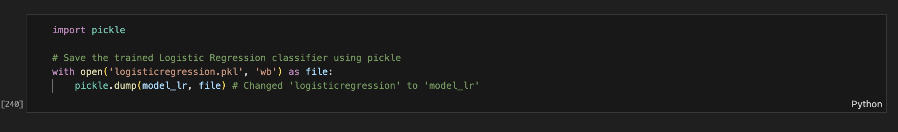
Using Streamlit for Deployment:
Step 1 : Dump the model in the pickle file
Step 2 : Prepare python file (.py) for deployement

Slide 20
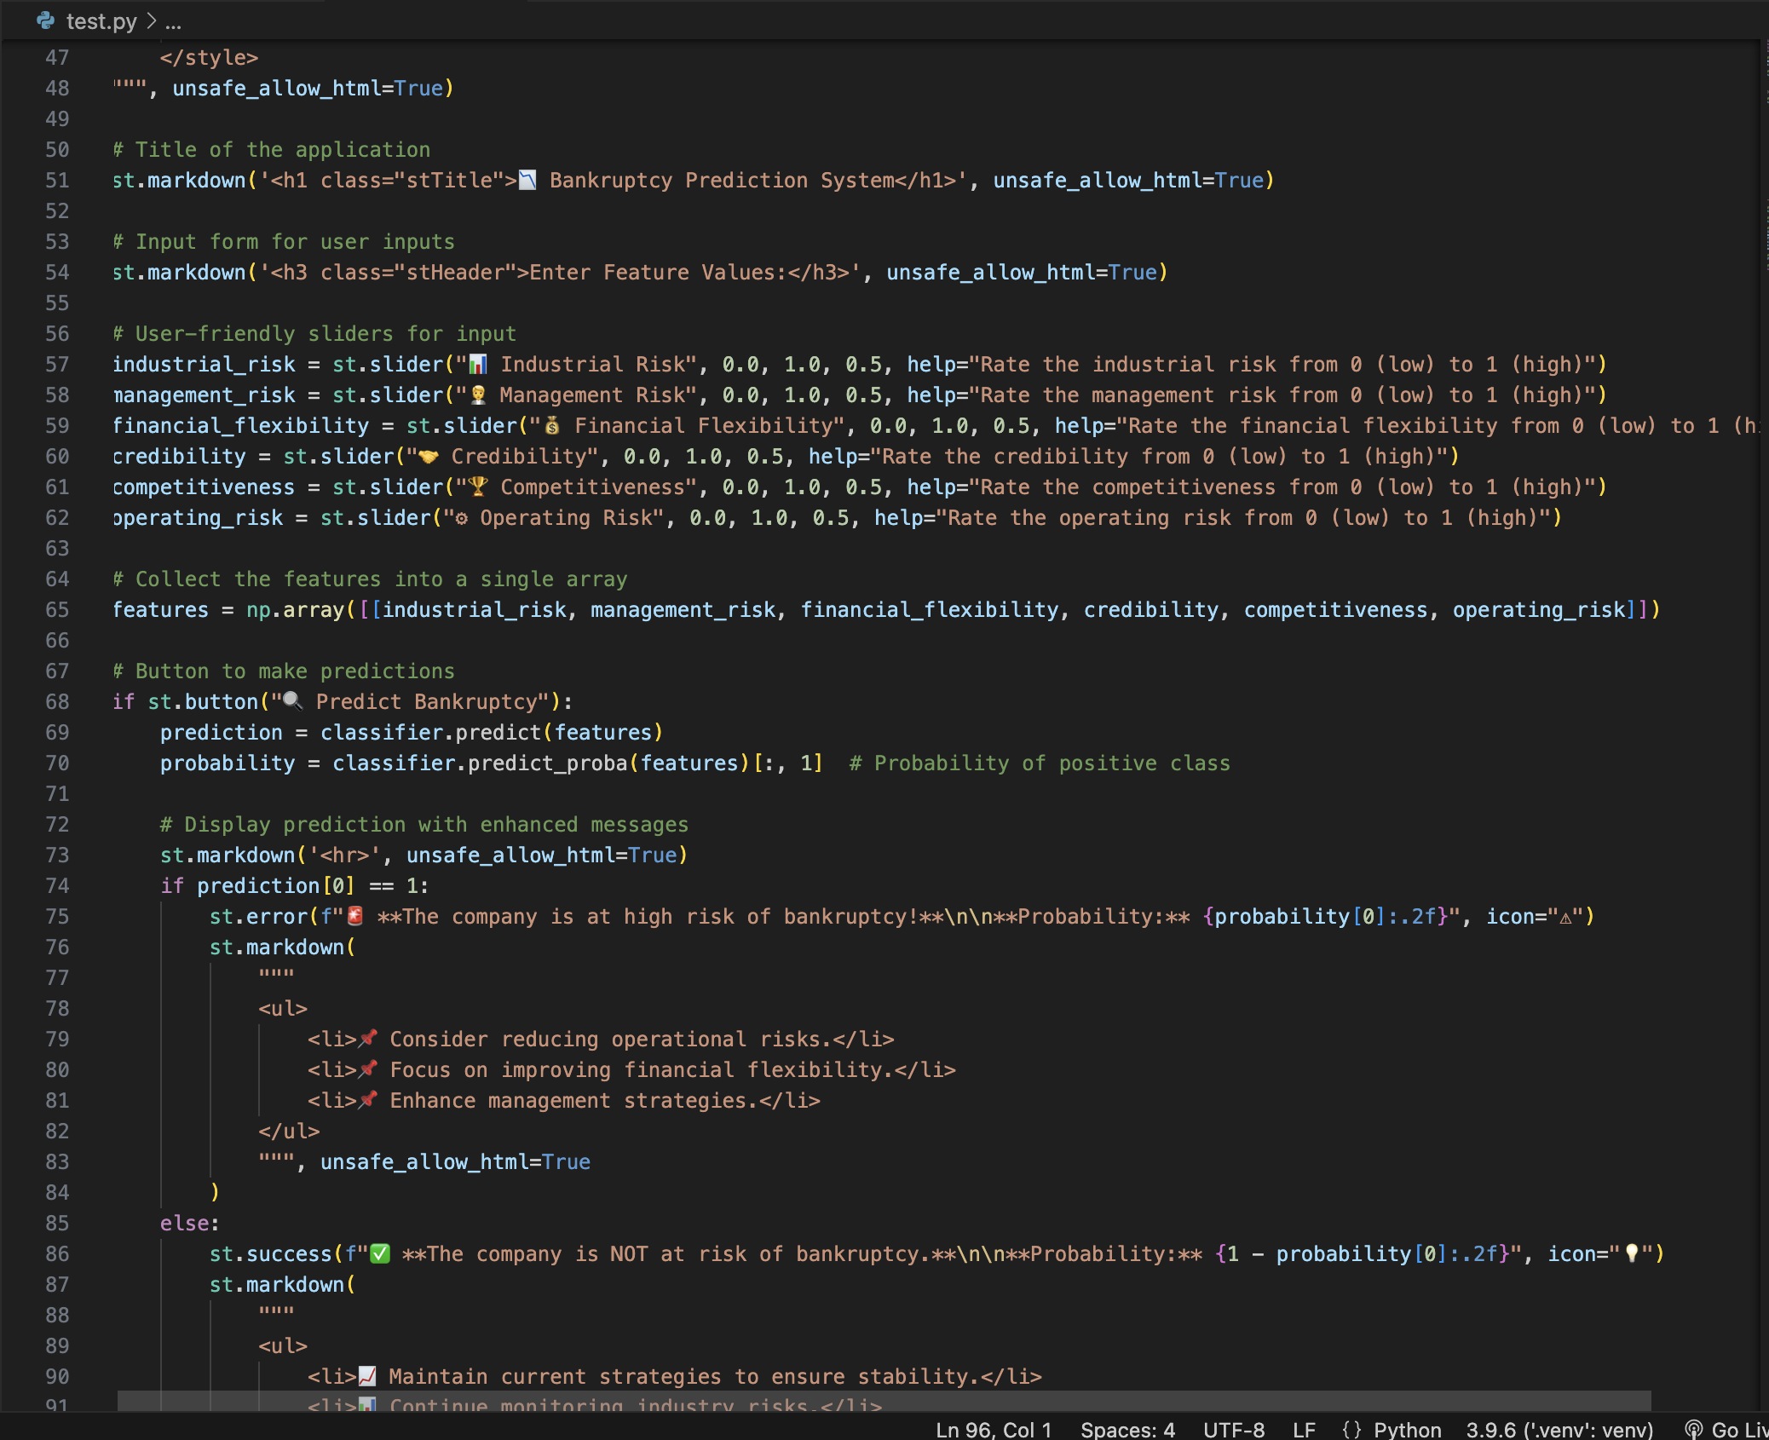
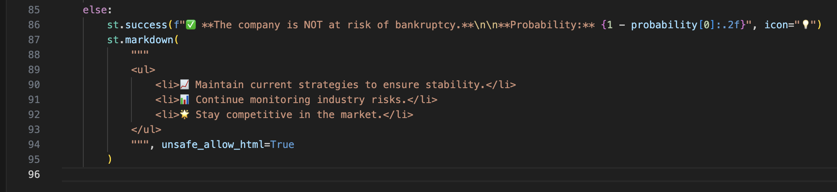

Slide 21

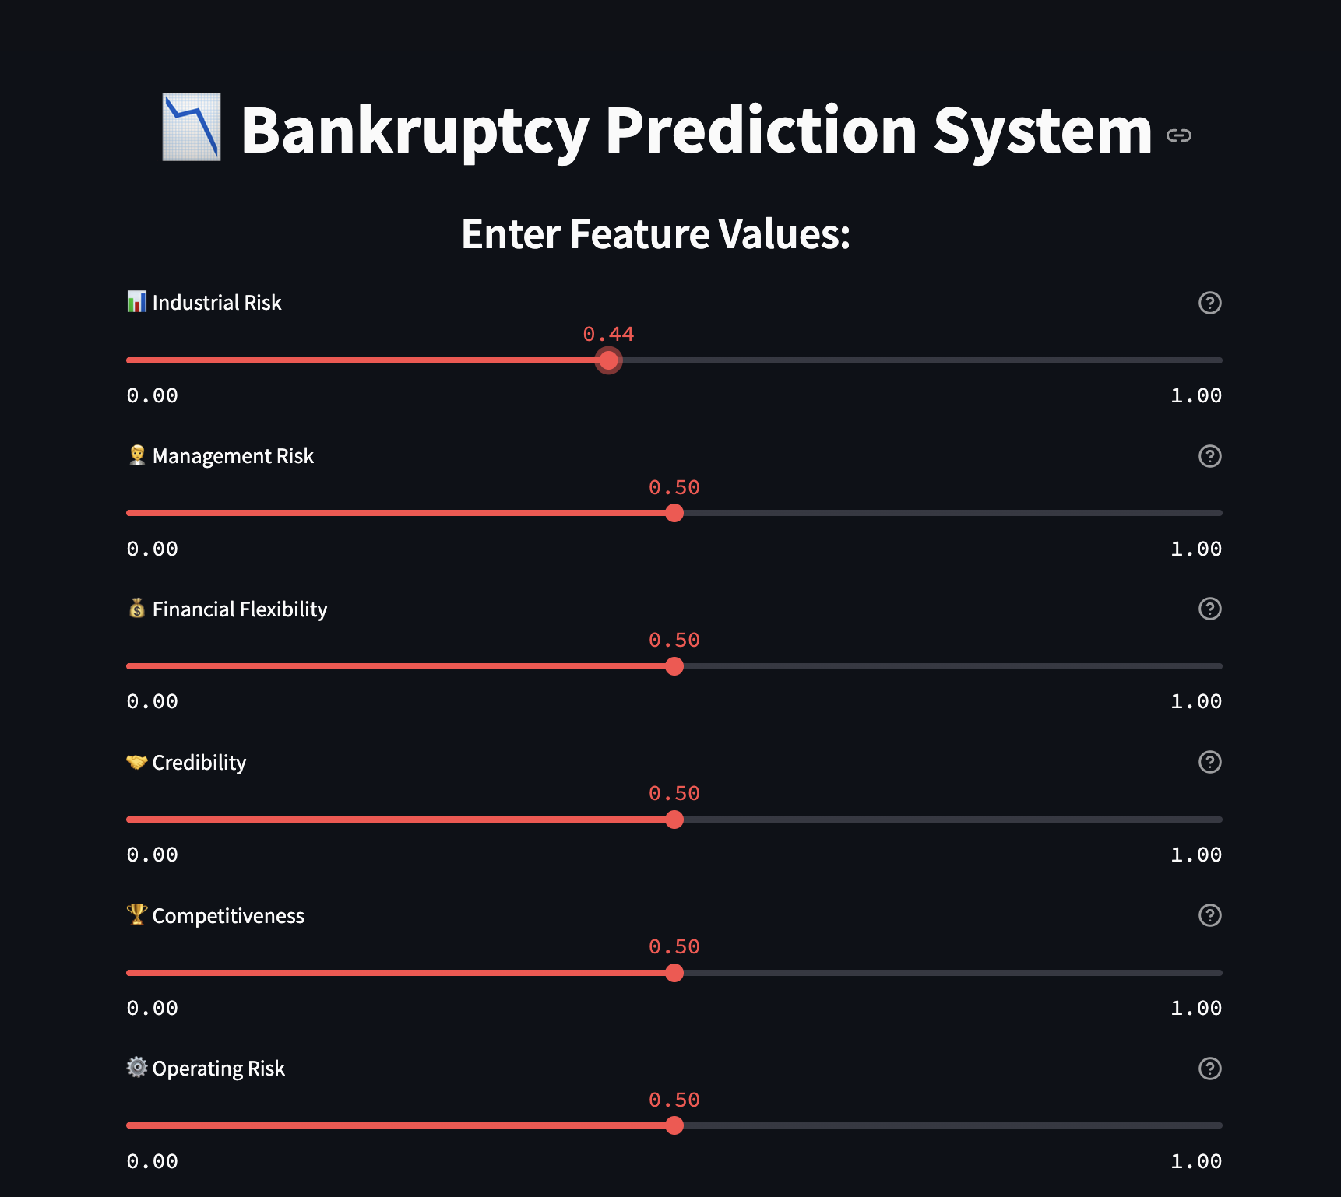
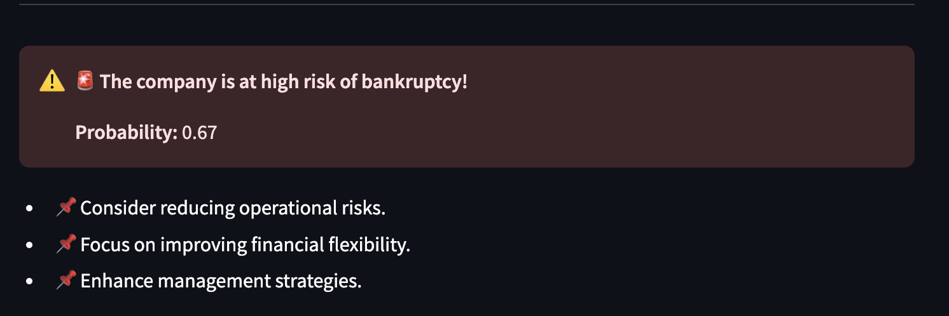
Streamlit Interface:
https://bankruptcy-prevention-project.streamlit.app/

Slide 22
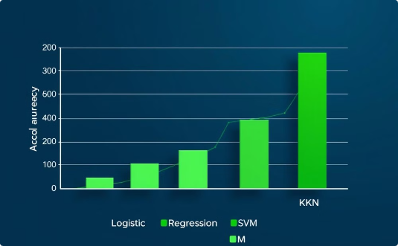

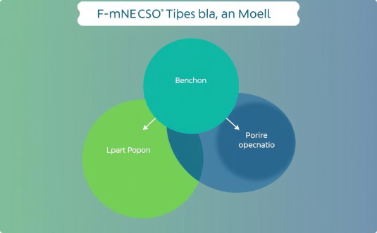
Conclusion:
High Accuracy
Efficiency
Explainability
Logistic Regression achieved the highest accuracy, indicating its effectiveness for this specific dataset.
The model's computational efficiency is crucial for real-world applications requiring fast predictions.
Its interpretability facilitates understanding of prediction rationale, enhancing trust and acceptance.

Slide 23

Thank you

